Slide 1
Construction of a Traditional Chinese Table Image and QA Dataset
Institute of Information and Communications W400 – Intern: SHU-CHI LIU
2024/12/20

Slide 2
Project Steps
1.Web Crawling
Collect high-quality Traditional Chinese web pages containing tables.
2.Table Extraction
Extract tables and related information (titles, descriptions) from HTML pages
Save them as JSON and CSV files.
3.Data Cleaning and Special Processing
Handle special cases such as merged-cell tables
Remove low-quality tables.
4.Table Visualization
Render tables in a browser and convert them into image files.
5.Question-Answer Text Generation
Use an LLM to generate relevant questions and answers based on the tables.

Slide 3
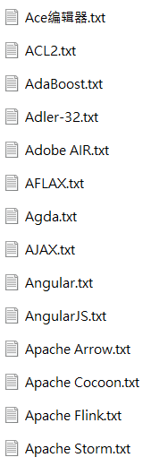
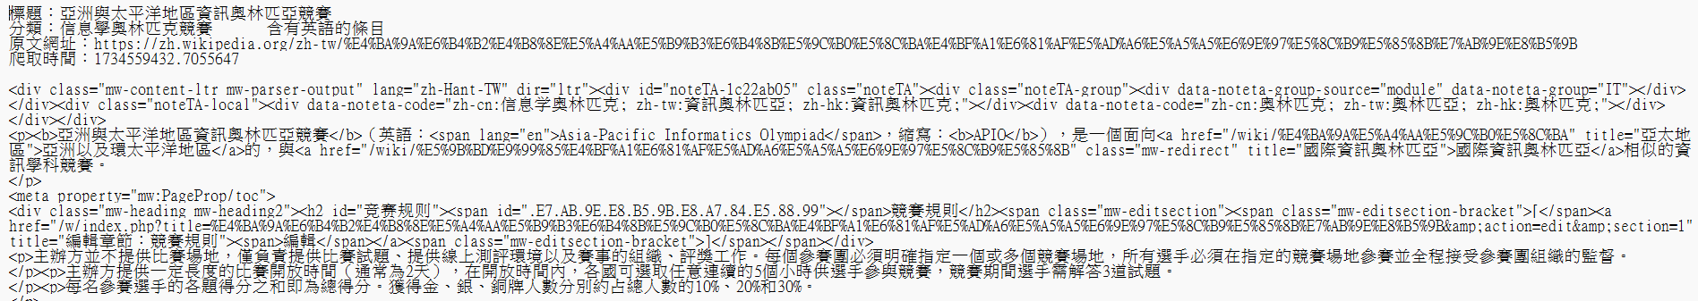
Web Crawling
High-quality Traditional Chinese table data: Traditional Chinese Wikipedia (https://zh.wikipedia.org/zh-tw/)
Web scraping tool:
GitHub: Traditional Chinese Wikipedia Data Scraping and Preprocessing (https://github.com/wjn1996/scrapy_for_zh_wiki)
Usage:
Provide a Wikipedia category page as the entry point.
Set filter keywords to limit scraping to specific topics.
Outcome:Collected 10,000 Wikipedia pages’ HTML, saved as TXT files.
List of scraped TXT files
HTML Example

Slide 4
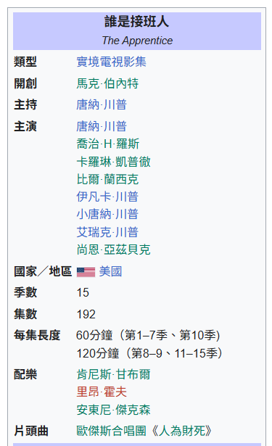
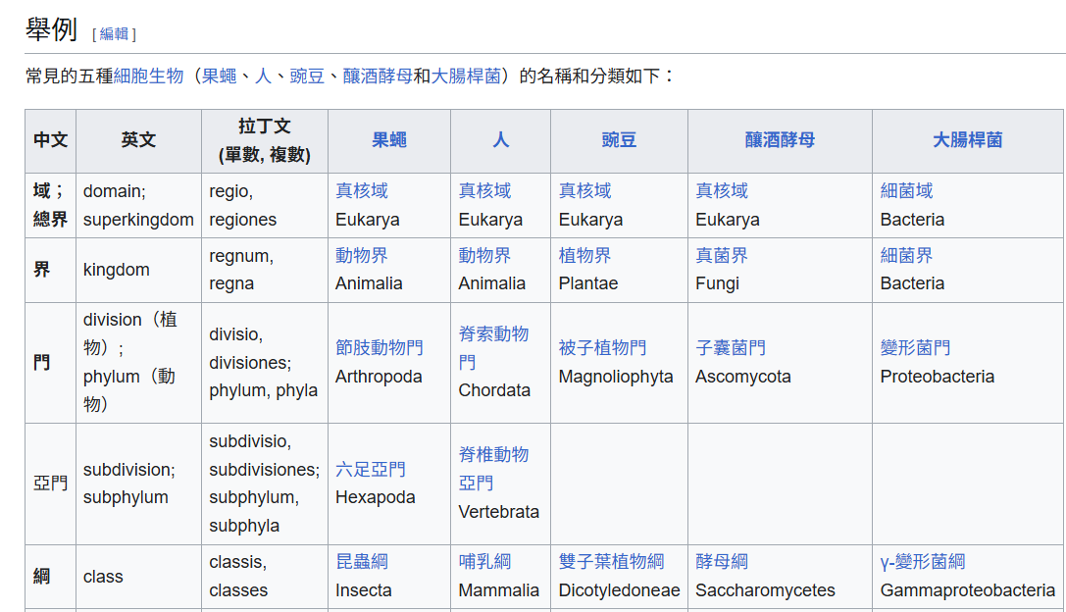
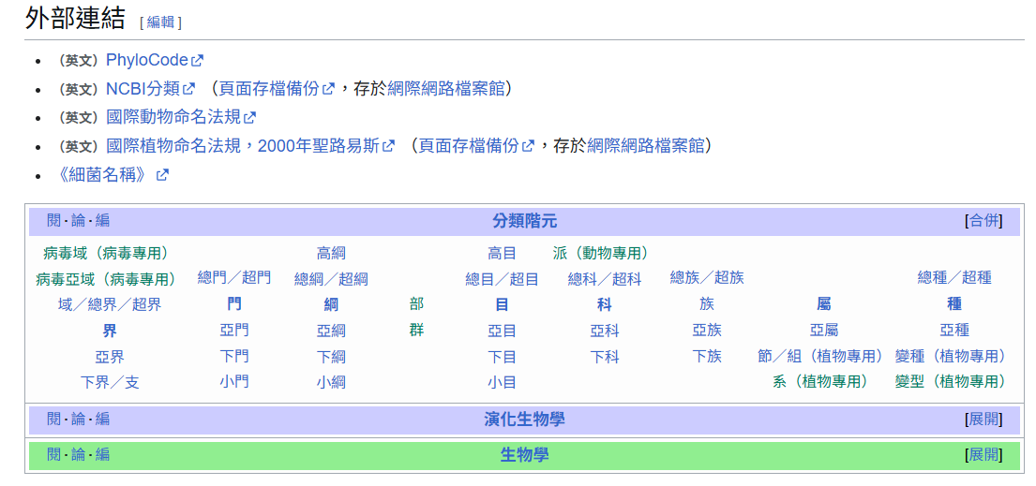
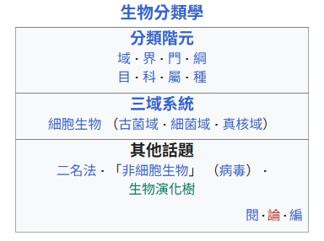
Table Extraction – Identifying Required Tables
Traditional Chinese Wikipedia contains four types of tables. Ultimately, only WikiTables were selected for extraction because their structure is more standardized, they are easier to extract along with related descriptions, and they have higher relevance to the page’s main topic.
Infobox
vevent
WikiTabe
Sidebar
Navbox

Slide 5
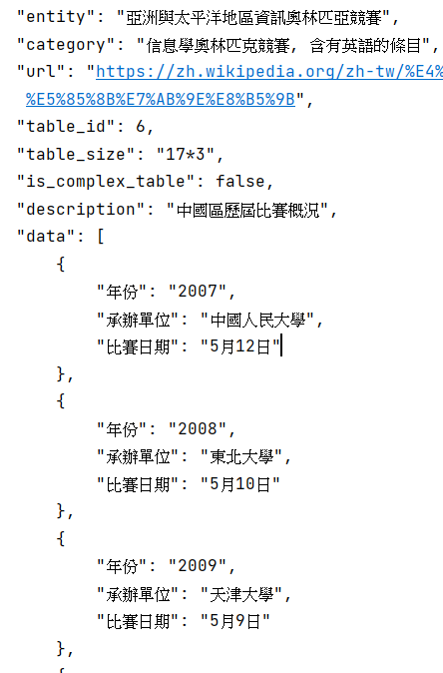
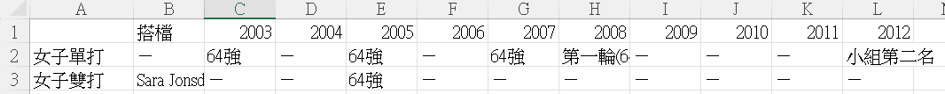
Table Extraction – Extract and Save as JSON and CSV
Extraction: Use XPath to locate and extract WikiTables within the HTML.
JSON Format
Entity: Wikipedia page title
Category: Wikipedia page category
Url: Wikipedia page URL
Table_id: Unique identifier
Table_size: rows*columns
Description: Section title where the table is located
Data: Table content
CSV: Store only the table content in tabular CSV format
JSON Data Example
CSV Data Example

Slide 6
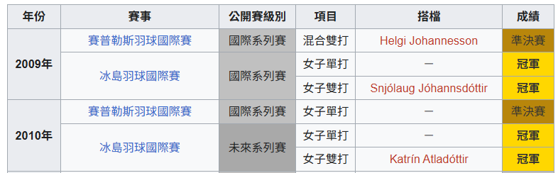
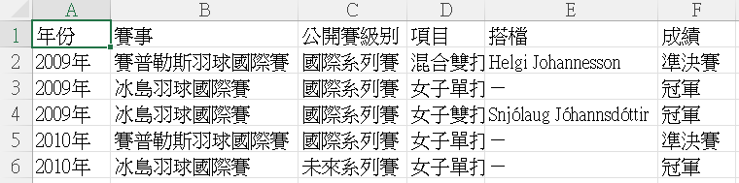
Special Data Processing
Special Data Processing – Merged-Cell Tables:
Merged-cell tables refer to structures where a single cell spans across multiple columns or rows.
In HTML, this is represented using the colspan or rowspan attributes.
In JSON and CSV, each row corresponds to one record with a fixed number of columns, which cannot directly represent merged cells.
Processing Method: Replicate the spanned value across all corresponding cells until the structure is normalized.

Slide 7
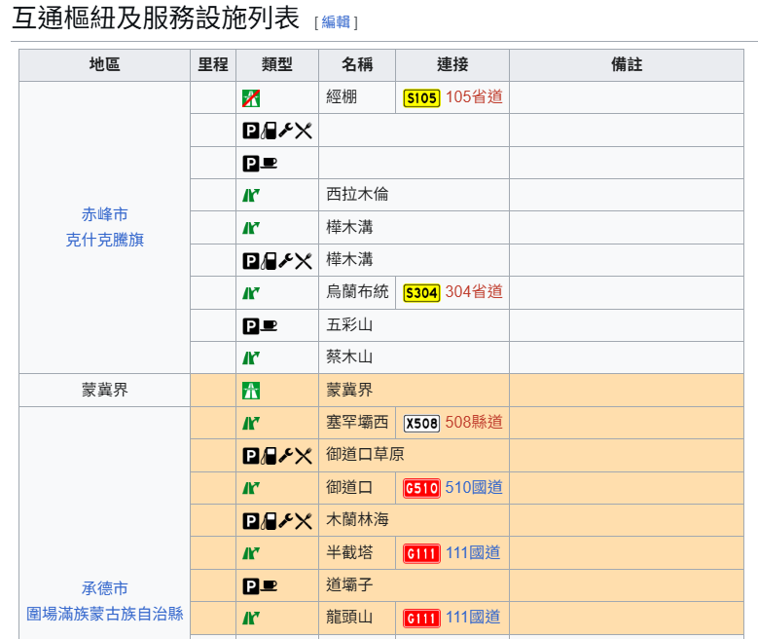
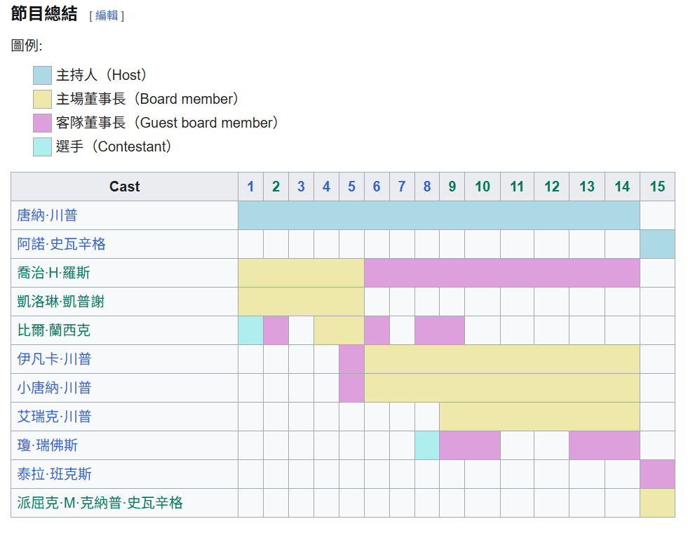
Data Cleaning
Unqualified tables can be removed based on the following criteria:
More than half of the table’s cells are empty values.
The table contains only one row or one column.
Example: Since images cannot be stored, they are treated as empty values. Therefore, the following table is discarded because more than half of its cells are empty.

Slide 8
Table Visualization
Ordinary tables can be stored in DataFrame format, but merged-cell tables (cross-column/row) require separate handling.
For ordinary tables:
Read the CSV file into DataFrame format.
Use the Playwright library to render images. By simulating the Chromium browser to process HTML and CSS, screenshots of the web content are captured.
This method allows customization of backgrounds, borders, fonts, etc., enabling the generation of diverse table images.
For merged-cell tables:
Read the HTML from the webpage TXT file.
Use Selenium WebDriver to render images.
The resulting merged-cell table images are almost identical to those displayed on Wikipedia pages.

Slide 9
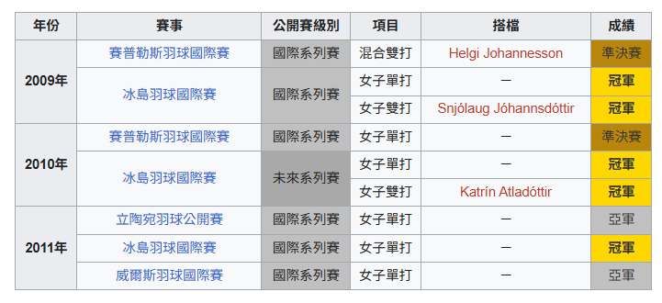
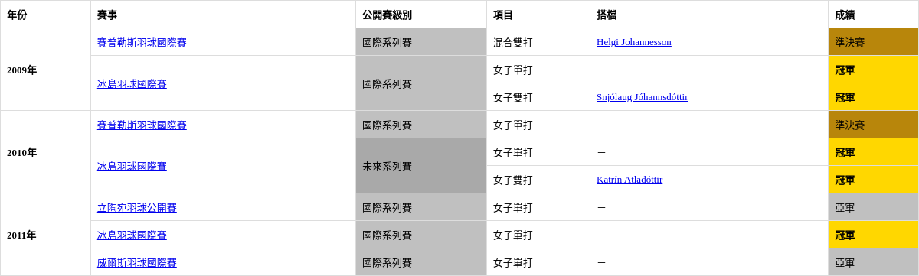
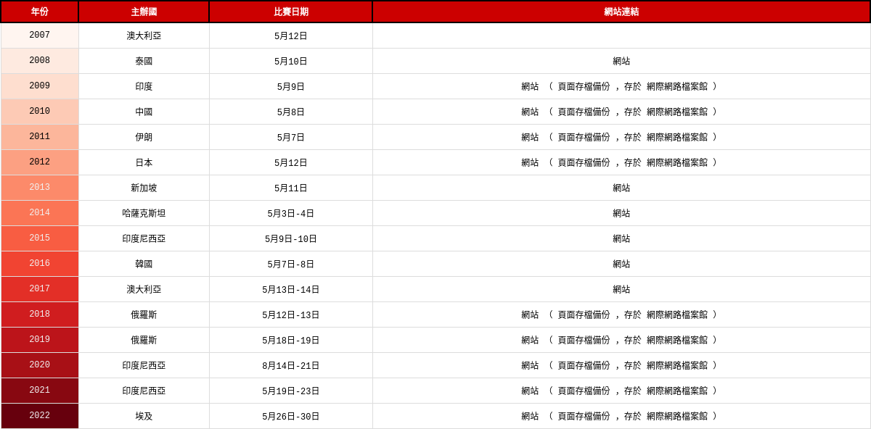
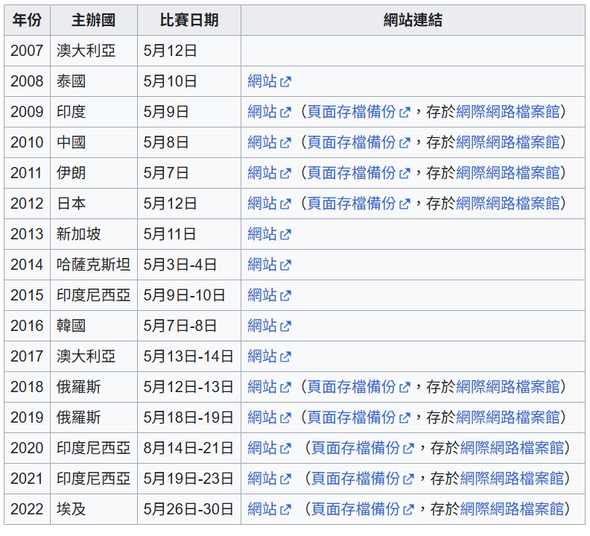
Table Visualization
Merged-cell tables:
Ordinary tables:

Slide 10
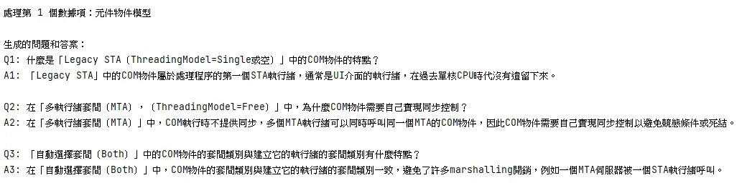
Question–Answer Generation
Referring to the paper ChartLlama: A Multimodal LLM for Chart Understanding and Generation, we adopt a large language model (LLM) to generate text-based questions and answers related to the table images.
Model Used: gpt-4o-mini
Input to the model: Three attributes from the JSON file — Entity, Description, and Data. The model is prompted to generate 3 sets of questions and answers based on this input.
The generated questions and answers are then saved as a JSON file.

Slide 11
Question–Answer Generation Process
1.Input the pre-processed JSON dataset into a large language model (via ChatGPT API) with a designed prompt and few-shot examples. The model generates questions for each table (referencing TableBench categories such as Comparison, Arithmetic Calculation, Ranking, etc.), and the question type is determined by whether the table contains time- or number-related terms.
2. Feed the generated questions back into the model for evaluation (criteria: clarity, answerability, independence, non-leading, etc.). Low-scoring questions are automatically refined into better versions.
3. Use the refined questions to generate answers with the model.
4. Evaluate the correctness of the answers with the model, refine them if needed, and extract the final outputs.

Slide 12
Traditional Chinese Table and Q&A Dataset
Sample Data
question | answer
拉娜·比約·因戈爾夫斯多蒂爾在2009年冰島羽球國際賽中的成績如何？(How did Ragna Björg Ingólfsdóttir perform at the 2009 Iceland International badminton tournament?) | 拉娜·比約·因戈爾夫斯多蒂爾在2009年冰島羽球國際賽中，女子單打項目中獲得了冠軍，女子雙打項目中與搭檔Snjólaug Jóhannsdóttir一起獲得了冠軍。(At the 2009 Iceland International, Ragna Björg Ingólfsdóttir won the women’s singles title and, together with her partner Snjólaug Jóhannsdóttir, also won the women’s doubles title.)
拉娜·比約·因戈爾夫斯多蒂爾在2010年的賽普勒斯羽球國際賽中取得了怎樣的成績？(How did Ragna Björg Ingólfsdóttir perform at the 2010 Cyprus International badminton tournament?) | 在2010年的賽普勒斯羽球國際賽中，拉娜·比約·因戈爾夫斯多蒂爾在女子單打項目中取得了準決賽的成績。(At the 2010 Cyprus International, Ragna Björg Ingólfsdóttir reached the semifinals in the women’s singles event.)
拉娜·比約·因戈爾夫斯多蒂爾在2011年的比賽中獲得了哪些獎項？(What titles did Ragna Björg Ingólfsdóttir win in tournaments in 2011?) | 拉娜·比約·因戈爾夫斯多蒂爾在2011年的比賽中，分別在冰島羽球國際賽和威爾斯羽球國際賽的女子單打項目中分別獲得了冠軍和亞軍的成績。(In 2011, Ragna Björg Ingólfsdóttir won the women’s singles title at the Iceland International and finished as the runner-up in the women’s singles event at the Welsh International.)

